Slide 1

Data-driven Koopman Analysis (Sparse Identification of Eigenfunctions)
111061590
林學謙

Slide 2
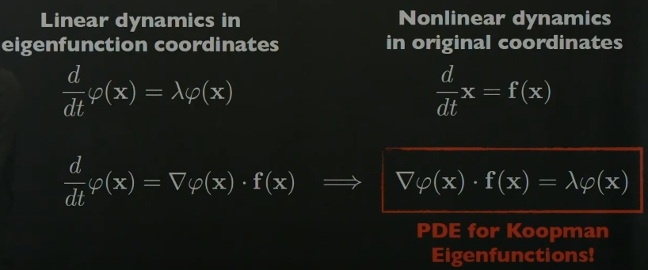
PDE for Koopman Eigenfunctions

Slide 3
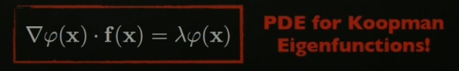
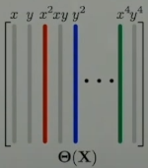
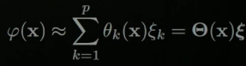
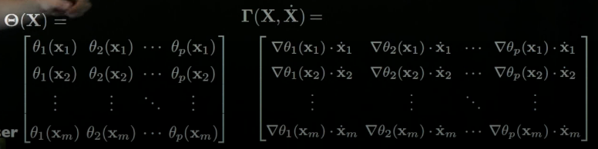
Finding the phi function by theta function

Slide 4
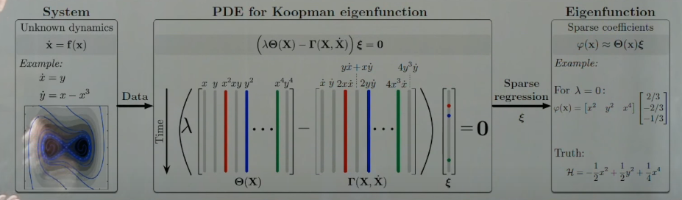
Sparse Regression

Slide 5
Advantage and Disadvantage
Advantage:
Without knowing system, especially nonlinear systems.
Disadvantage:
Data quality

Slide 6
References
https://www.youtube.com/watch?v=--J7F6khJD0&list=PLMrJAkhIeNNR6DzT17-MM1GHLkuYVjhyt&index=10&t=1s&ab_channel=SteveBrunton

